Slide 1
Occupation Based Risk Database
By Gopalakrishnan Kumar, MTech IIT-Bombay,
Freelance Data Science Consultant
LinkedIn: Profile Link : https://www.linkedin.com/in/gopalakrishnankumar-a73301110/
Github:https://github.com/Gopal21236/
Kaggle URL- https://www.kaggle.com/gopalkk2

Slide 2
Google Colab URL
https://colab.research.google.com/drive/1jB7Rt04H3EWs4I3wETjwTJVCxEYZ0YmJ?usp=sharing

Slide 3
Introduction
Occupation is one of the most critical variables in insurance underwriting and risk assessment. Different professions expose individuals to varying levels of physical hazards, psychological stress, and accident probability. Accurately quantifying this exposure is essential for fair premium pricing, risk pooling, and sustainable insurance operations.
Traditional underwriting approaches often rely on static occupation labels or manual judgment, which can lack transparency and scalability. This project addresses this gap by designing a data-driven, rule-based Occupation-Based Risk Database that converts occupational characteristics into quantifiable risk scores and underwriting decisions using Python analytics.

Slide 4
Objective of the Project
The primary objectives of this project are:
To design a structured database capturing occupation-specific risk factors
To quantify occupational risk using measurable and interpretable components
To compute a composite occupational risk score
To classify occupations into standardized risk categories
To support underwriting and premium decision-making
To visualize occupational risk distribution and composition

Slide 5
Dataset Description
A simulated dataset representing common professions is used for analytical demonstration.
Dataset Attributes –
Attribute | Description
Occupation | Job role of the individual
Physical Risk Score | Physical strain and injury exposure
Stress Risk Score | Psychological and mental workload
Accident Risk Score | Probability of work-related accidents
Each risk score ranges from 1 (Low Risk) to 10 (High Risk).

Slide 6
Risk Scoring Methodology
Occupational risk is multidimensional. To capture this, a composite risk score is calculated using weighted aggregation:
Physical Risk: 40%
Stress Risk: 30%
Accident Risk: 30%
Composite Risk Formula –
Overall Risk Score=0.4×Physical Risk+0.3×Stress Risk+0.3×Accident Risk
This weighting reflects insurance industry priorities, where physical and accident risks often result in higher claim severity.

Slide 7
Risk Classification Logic
Based on the computed overall risk score, occupations are categorized into:
Risk Category | Interpretation
Low Risk | Preferred underwriting
Medium Risk | Standard underwriting
High Risk | High premium or restricted coverage
This rule-based classification ensures transparency, consistency, and explainability—key requirements in regulated insurance environments.

Slide 8
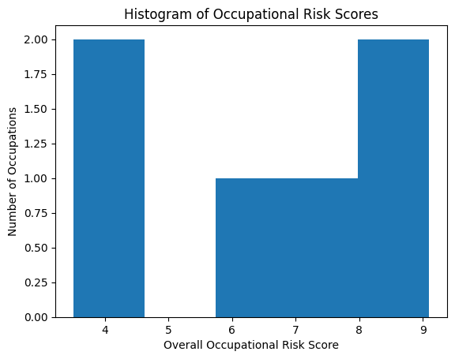
Data Visualization

Slide 9
Visualization and Analytics
6.1 Histogram – Distribution of Occupational Risk Scores
Purpose:
To examine how occupational risk scores are distributed across professions.
Insights:
Clear separation between low, medium, and high-risk occupations
Concentration of high-risk scores at the upper end of the distribution
Supports the validity of threshold-based classification
Business Value:
Helps insurers assess portfolio-level risk concentration and diversification.

Slide 10
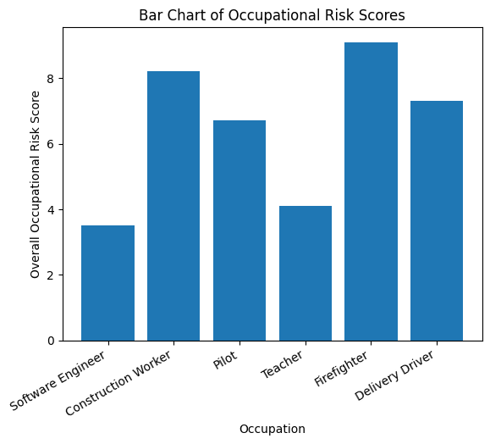
Data Visualization

Slide 11
Visualization and Analytics
6.2 Bar Chart – Overall Risk Comparison by Occupation
Purpose:
To compare overall occupational risk scores across different professions.
Insights:
Physically intensive professions (e.g., firefighters, construction workers) exhibit higher risk
Desk-based professions show consistently lower risk
Medium-risk professions occupy a clearly defined middle range
Business Value:
Enables premium differentiation and underwriting prioritization.

Slide 12
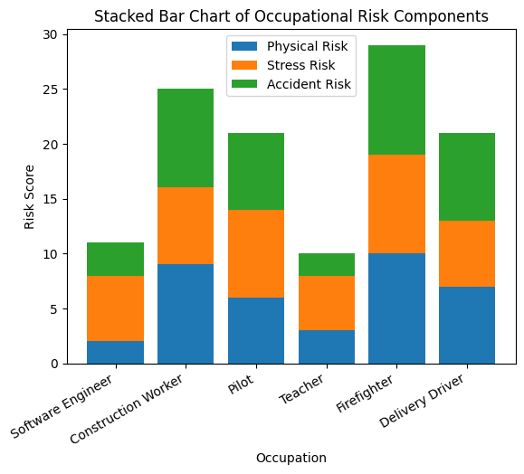
Data Visualization

Slide 13
Visualization and Analytics
6.3 Stacked Bar Chart – Risk Component Decomposition
Purpose:
To identify which risk factors drive total occupational risk.
Insights:
High-risk occupations show strong contributions from all components
Some professions are dominated by specific risk types (e.g., stress or accident exposure)
Provides explainability for underwriting decisions
Business Value:
Supports component-specific policy exclusions, riders, and pricing adjustments.

Slide 14
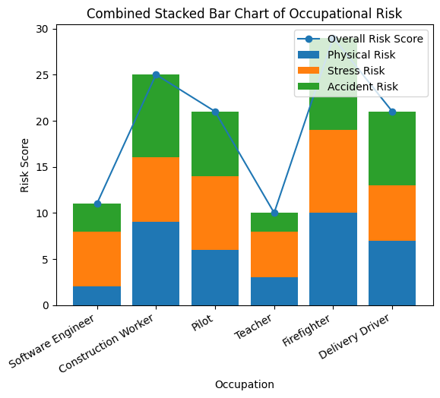
Data Visualization

Slide 15
Visualization and Analytics
6.4 Combined Stacked Bar Chart – Integrated Risk View
Purpose:
To combine risk composition and overall risk magnitude in a single visualization.
Insights:
Simultaneous assessment of total risk and its drivers
Easy cross-occupation comparison
Highlights occupations requiring underwriting attention
Business Value:
Ideal for management dashboards and underwriting committees.

Slide 16
Underwriting Decision Framework
Each risk category is mapped to an underwriting action:
Risk Category | Underwriting Decision
Low Risk | Preferred premium
Medium Risk | Standard premium
High Risk | High premium / restricted coverage
This converts analytical outputs into actionable insurance decisions.

Slide 17
Business Impact
The proposed occupational risk database offers multiple advantages:
Improves fairness and transparency in underwriting
Reduces subjectivity in occupation-based decisions
Enables scalable risk assessment across large customer bases
Enhances regulatory compliance through explainable logic
Supports data-driven premium pricing

Slide 18
Limitations
Dataset is simulated and does not include real claims data
Static risk scores do not capture individual-level variation
No temporal or demographic factors included

Slide 19
Future Enhancements
Integrate historical claims data for calibration
Apply machine learning for dynamic risk prediction
Incorporate demographic and lifestyle variables
Add time-based risk evolution analysis
Include transaction-level underwriting cost modeling

Slide 20
Conclusion
This project demonstrates how a rule-based occupational risk database can convert qualitative job characteristics into quantitative, underwriting-ready insights. By combining structured risk scoring, transparent classification logic, and decision-oriented visualization, the framework bridges the gap between occupational data and real-world insurance decision-making.

